Slide 1
Customer Analysis On Olist E-Commerce Data
Presentor: Hongxuan An, Xingjian Liu
Notes:
Hi and welcome to our presentation! I am Xingjian, and together with Hongxuan, we are thrilled to share with you about our topic for this project: Customer Analysis on Olist E-Commerce Data.

Slide 2
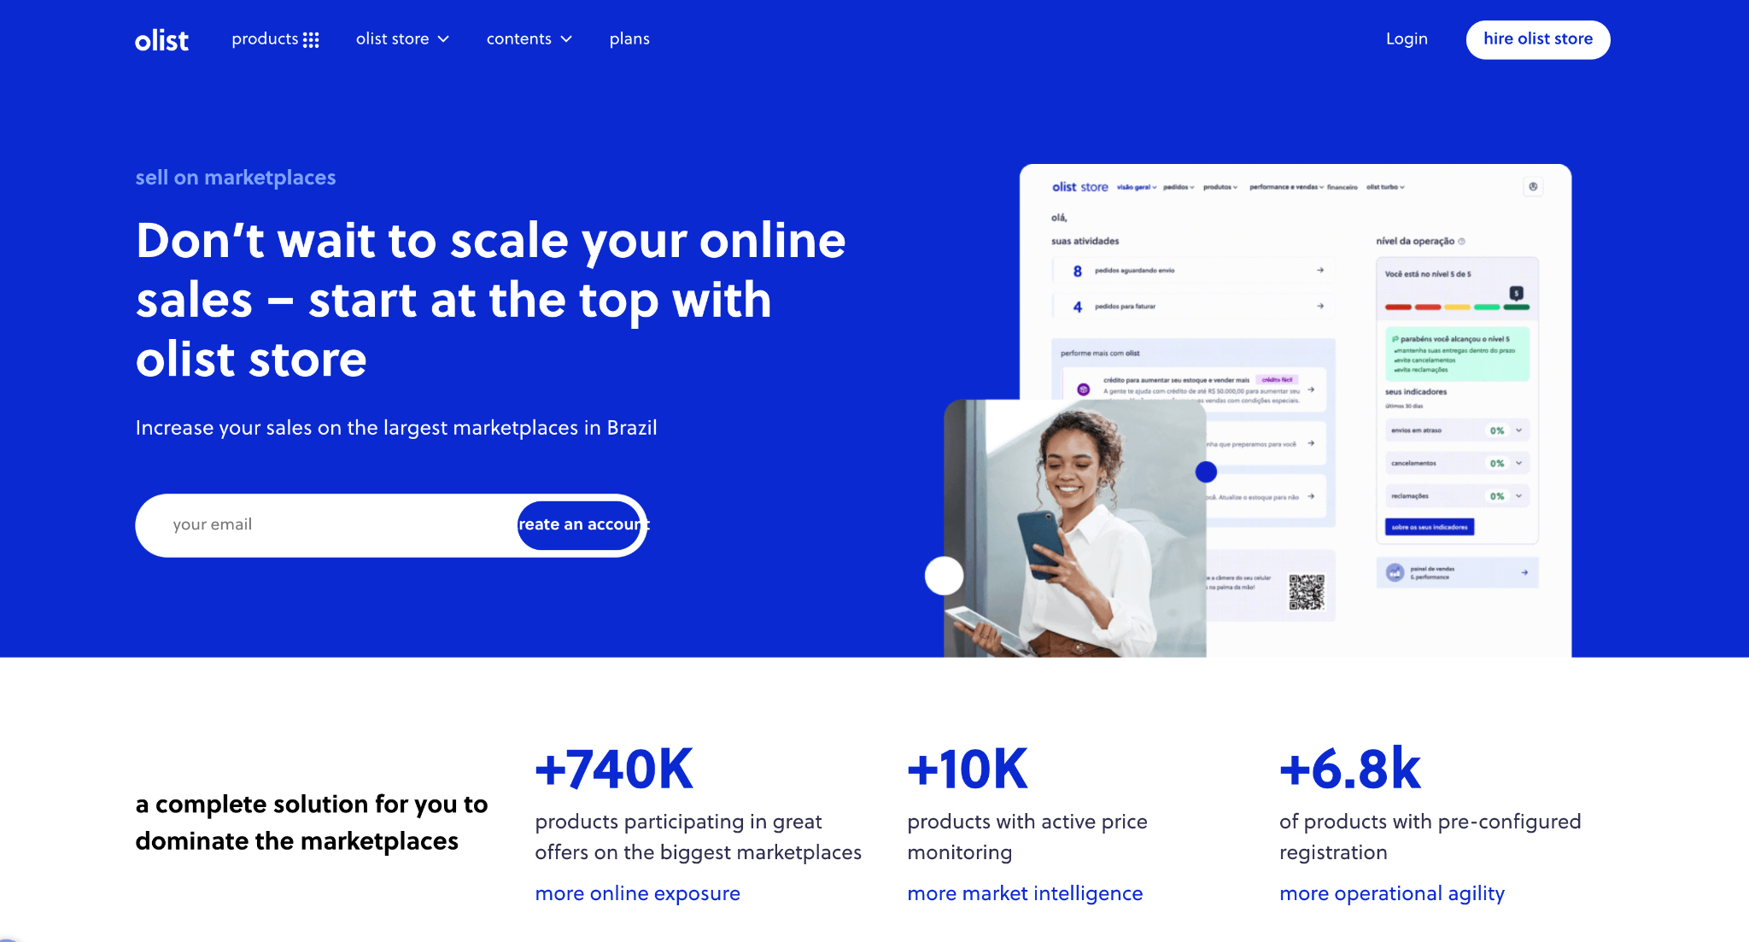
Topic & Objective
Enhance Customer Experience
for Olist E-Commerce Platform
Analyze customer behavioral patterns from transactional data
Group customers by common patterns and profile segmentation
Derive personalized marketing strategies for targeted groups
Notes:
So Olist is a Brazilian e-commerce platform that connects small businesses to customers across Brazil. The primary objective of our project is to conduct a comprehensive customer analysis into the customer behavior patterns from the online transactional data, so as to derive actionable insights via customer segmentation, thereby enhancing customer experience and fostering sustainable growth.

Slide 3
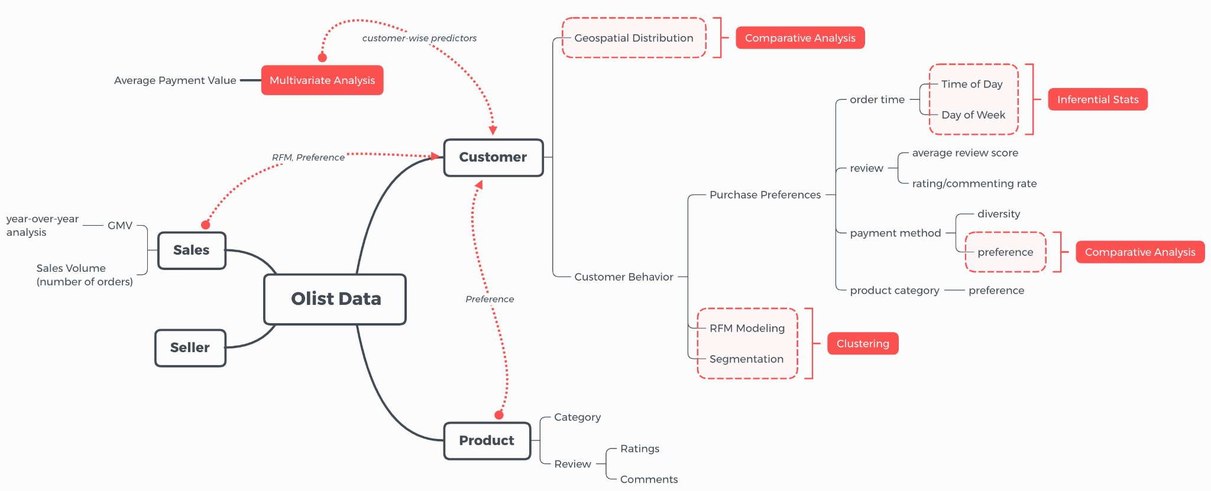
Topic & Objective
Notes:
In analyzing the customer data, our goal is divided into mainly three aspects: first, customer and platform EDA; second, statistical analysis on customer purchase preference; and finally, rfm modeling and customer segmentation using clustering methods.

Slide 4
Catalogue
Data Overview
Data Inspection
Feature Engineering
Exploratory Data Analysis: customer & platform
Statistical Analysis: customer purchase preference
Customer Segmentation
RFM Modeling
General Segmentation & Profiling
Insights & Strategies
Notes:
So here is the catalog. We’ll start with a brief introduction to our data before we dive into the statistical and machine learning parts.

Slide 5
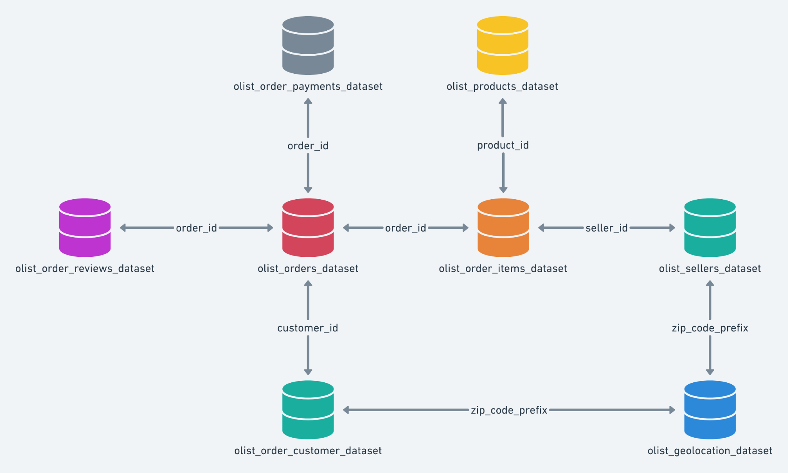
Data Inspection
Database
Schema
Notes:
The data was obtained from Kaggle provided by Olist, which is divided into multiple datasets connected by foreign keys. And the data schema is shown here.

Slide 6
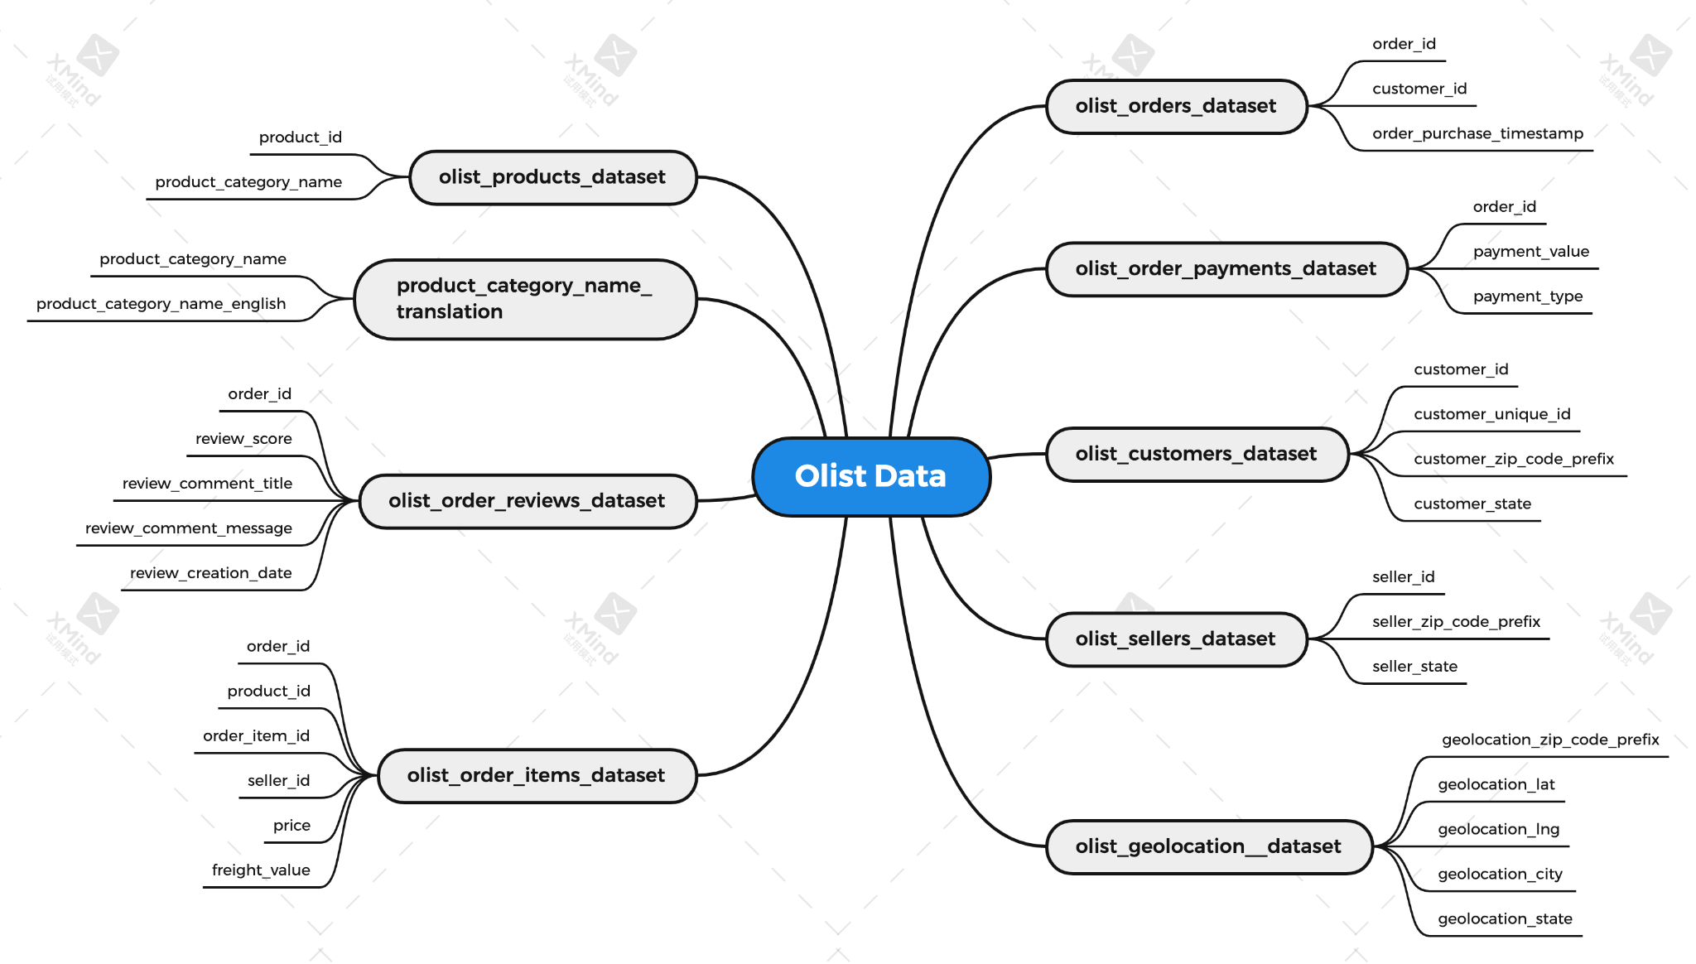
Data Inspection
Notes:
From this, we selected the datasets and variables related to customer purchasing behaviors for subsequent analysis

Slide 7
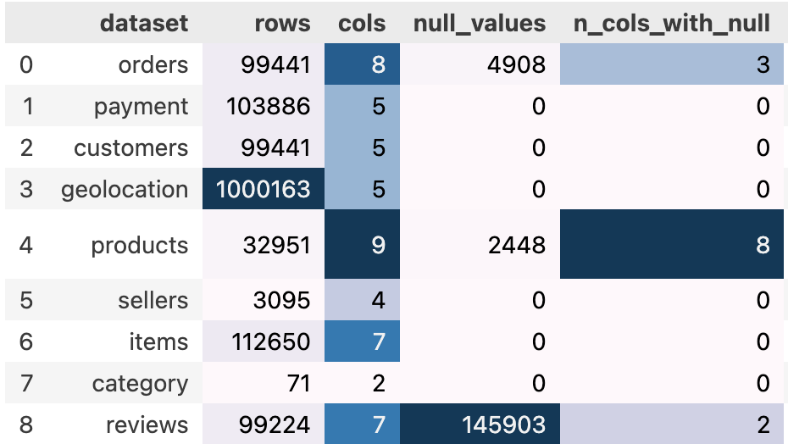
Data Inspection
Notes:
We inspected missing values, duplicates and weird patterns that need to be addressed skillfully subsequently.

Slide 8
Feature Engineering
Geolocation Processing
Zip Code Prefix → Lat & Long
Constrain to Brazil
Group into states
Customer
Geolocation Distribution
Merge
Datasets
Timestamp Processing
Extract time series features
year, month, dayofweek, hour
Order
Purchase
Time
Notes:
For feature engineering, we first processed the customer geolocation features and time series features for order purchase, and merged datasets to a whole.

Slide 9
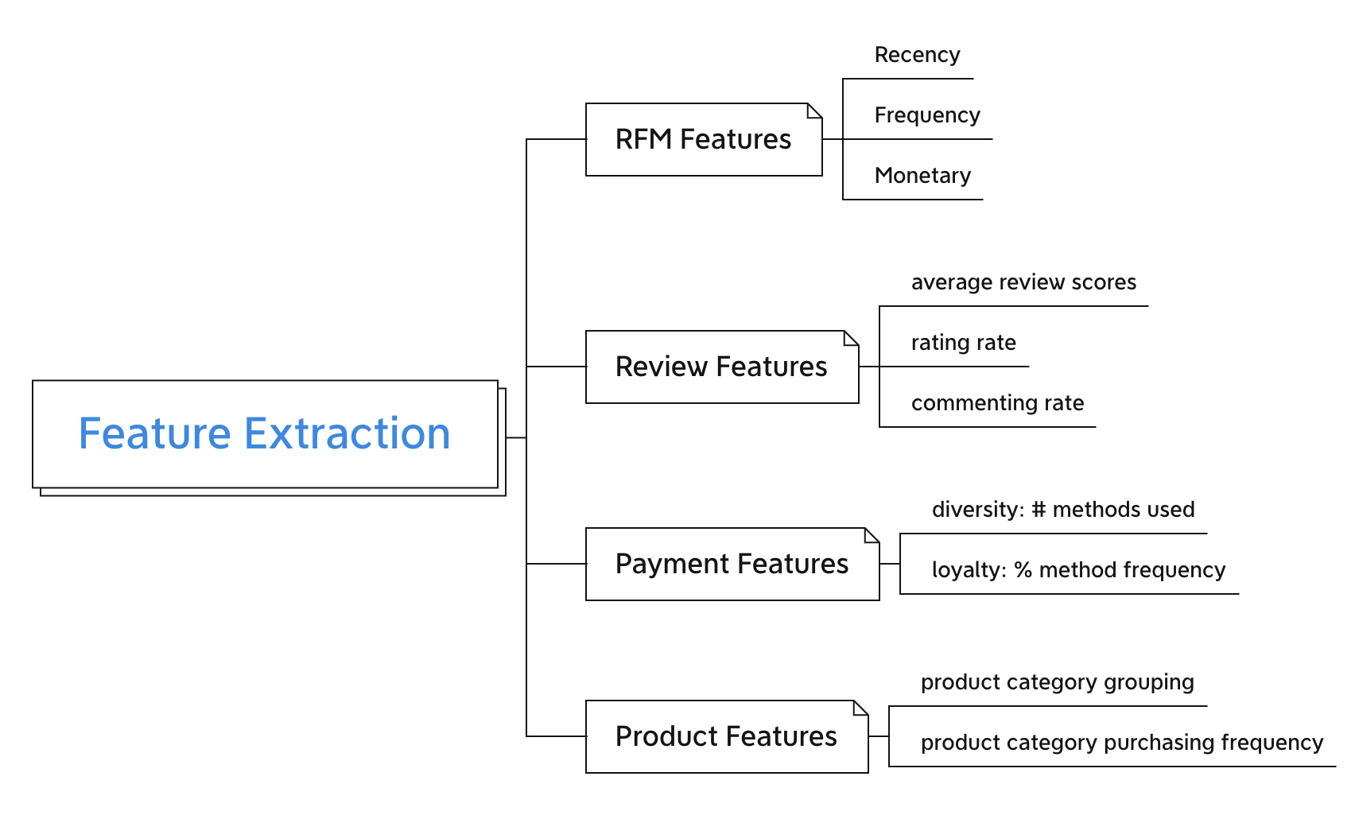
Feature Engineering
Notes:
Then we extracted useful features from the raw transactional data: the RFM, review features, payment method features and product purchasing features, which enables subsequent analysis on customer segmentation.

Slide 10
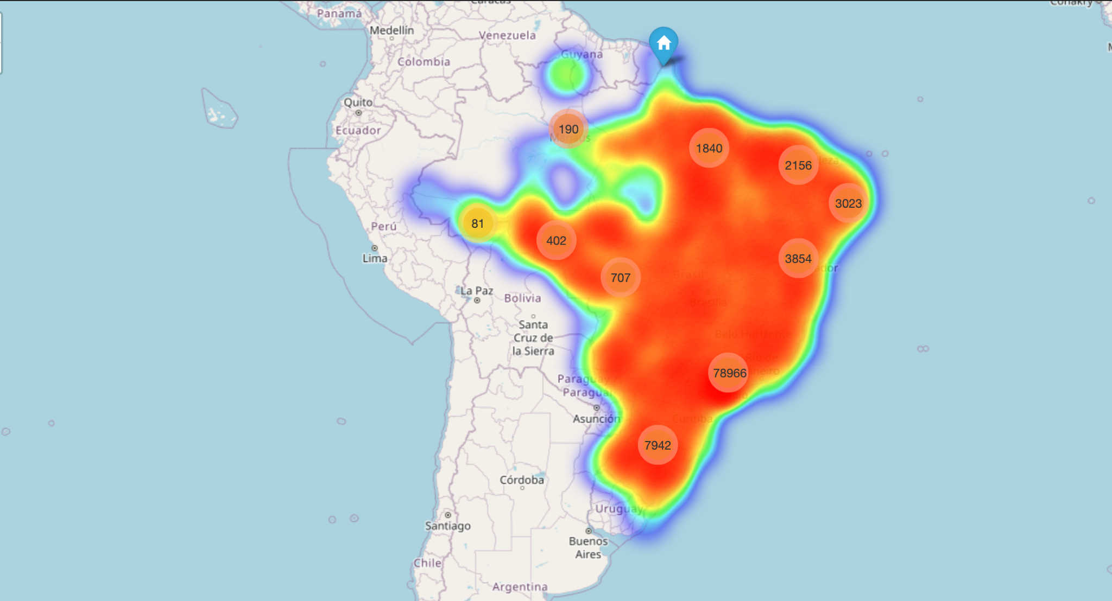
EDA: Customer Geolocation Distribution
Notes:
For EDA, we first examined the geolocation distribution of customer orders, and concluded that the right central region has the highest number of orders, reflecting a high concentration of purchasing power.
Let’s look at the geolocation distribution of orders. From the map, we can see that São Paulo(圣保罗)which is right centrol are of Brazil, has the highest number of orders. Since São Paulo is the most populous and wealthiest state in Brazil.
From above we can see that São Paulo state has the highest number of orders. São Paulo is the most populous and wealthiest state in Brazil, whose GDP accounts for approximately one-third of Brazil's total, reflecting a high concentration of purchasing power. Several actionable insights are:
* Olist can focus on strengthening partnerships with local logistics providers within São Paulo to enhance delivery efficiency and service quality.
* Olist can analyze purchasing patterns within São Paulo to offer personalized recommendations, promotions, and products that cater to the local market's preferences.

Slide 11
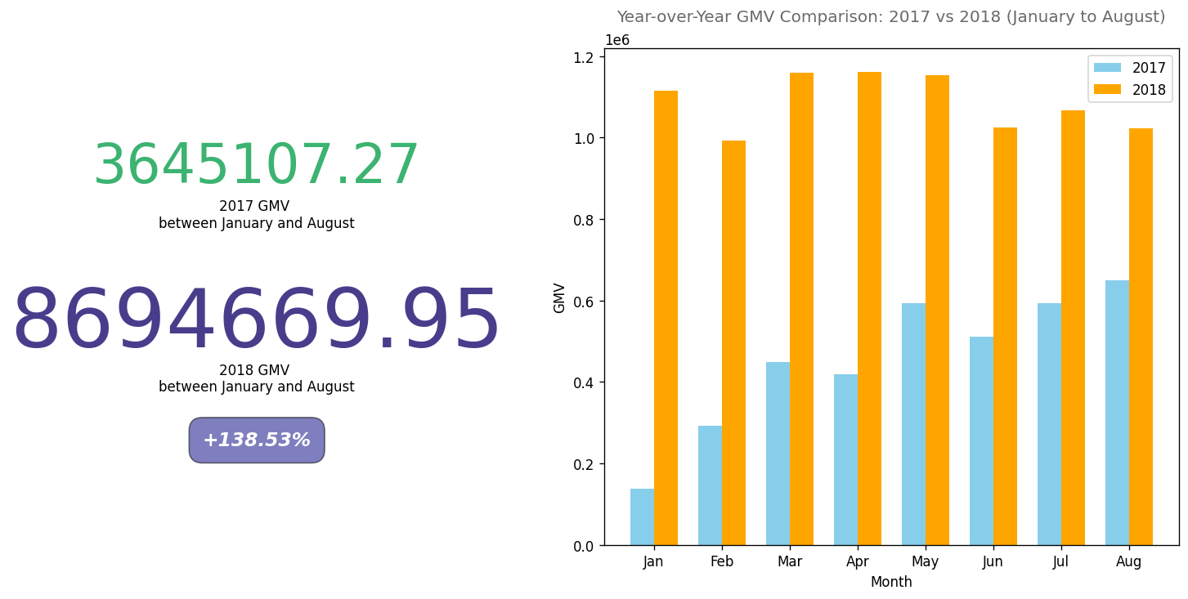
EDA: Platform GMV Trend
Notes:
GMV can be a clear indicator of platform's health and growth. We conducted year-over-year analysis of the monthly GMV trend, and concluded a rapid development of Olist
We also curious about GMV is the total value of merchandise sold over a certain time period through the platform. To ensure the effectiveness, We will be focusing on data between Jan - August for year 2017&2018.we observed that the GMV of Olist in 2018 was 138% higher than 2017, with each month showing a year-over-year growth.
presenting a picture of robust and accelerating growth during this period. This substantial increase in GMV suggests putting a stronger focus on customer acquisition, platform technology improvements, and a potential of market expansion.
We also curious about GMV is the total value of merchandise sold over a certain time period through the platform. For a marketplace like Olist, which connects sellers and buyers, GMV can be a clear indicator of the platform's health and growth. Let’s see the GMV trend by different payment methods. From the graph shows, the most order contributed by credit card payment. we found out that the GMV after 08/2018 is only composed of 'Voucher' payments, which is pretty weird. To ensure the effectiveness, We will be focusing on data between Jan - August for year 2017&2018

Slide 12
Statistical Analysis:
Customer Purchase Preference
Notes:
Then it comes to statistical analysis for customer purchase preference.

Slide 13
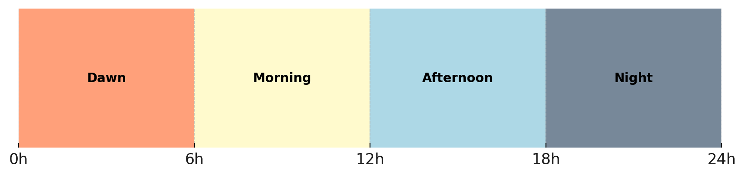
Purchase Preference By Time
By time of day
Monday | Tuesday | Wednesday | Thursday | Friday | Saturday | Sunday
By day of week
Notes:
We will be first focusing on the correlation between the number of purchasing orders and the time factors, the time of day and day of week, respectively.

Slide 14
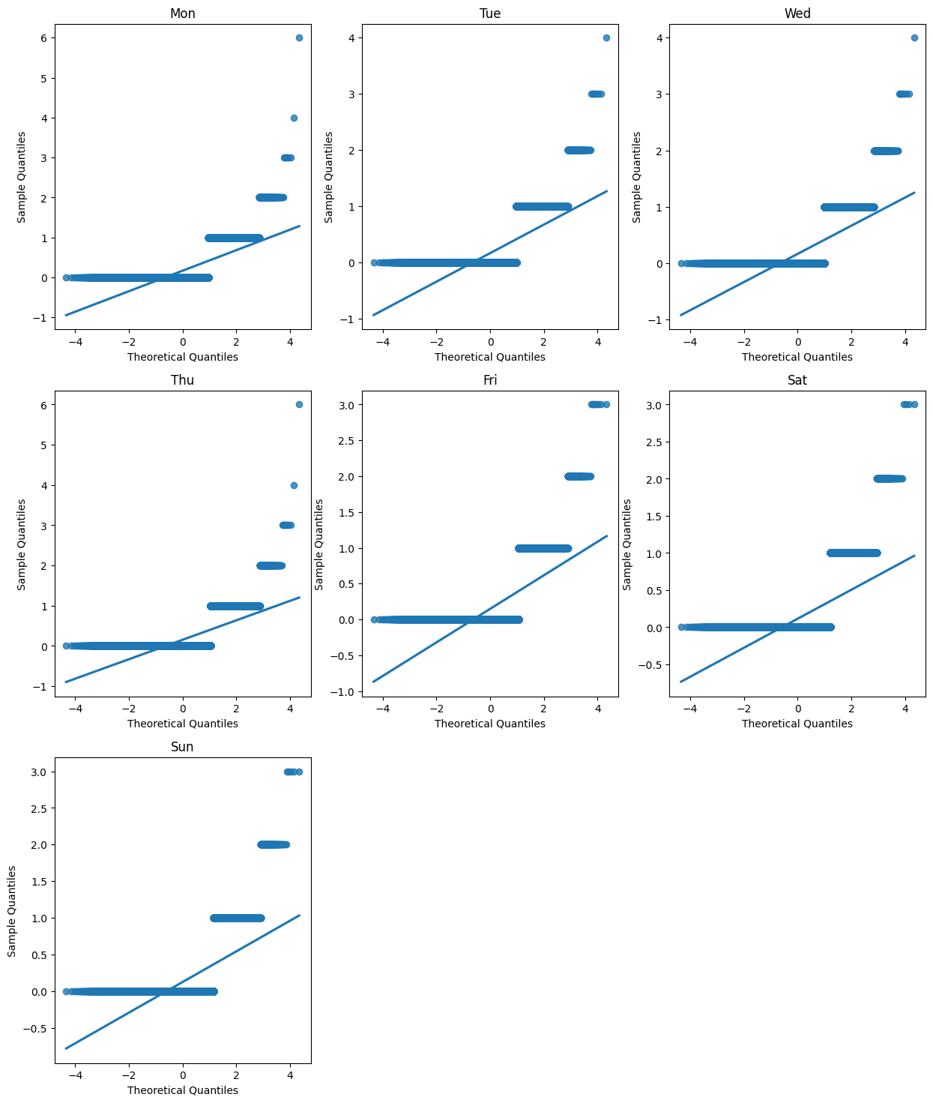
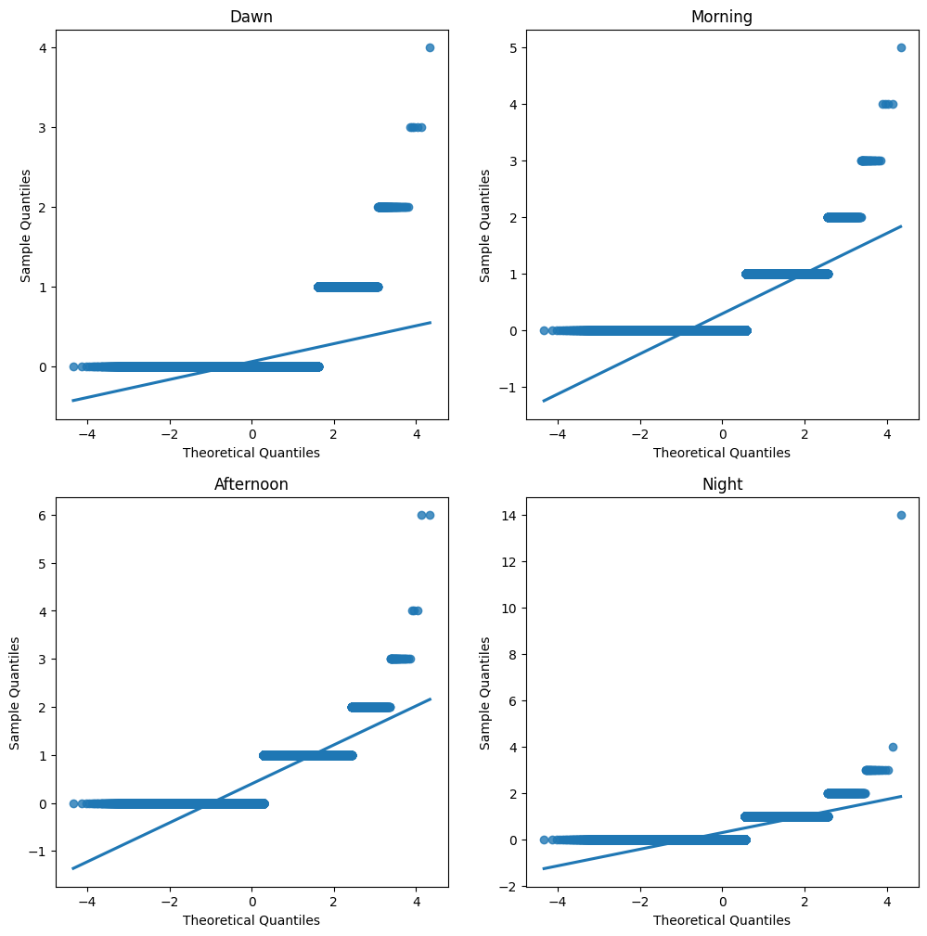
Check ANOVA Assumption:
Normality (QQ-Plot)
Both
Far
From
Normal
Notes:
At first, we want to implement ANOVA. So we checked the normality assumption by QQ plot, which indicates skewness.
At first we want to analyze with ANOVA. So we check the normality assumption by QQ plot. QQ-plot indicates that the number of orders for each of the 4 levels of time period are all not normally distributed. That is particularly because of data sparsity: 97% of the customers only purchased once on Olist platform, resulting in many 0's in order_daybytime.

Slide 15
Kruskal-Wallis Hypothesis Test
An alternative to ANOVA
Non-parametric method
Assumption simpler: independent & ordinal (does not require normality)
H0 vs H1
Significance level = 0.05
from scipy.stats import kruskal
Result
Kruskal-Wallis H test statistic: 30609.89419331755
P-value: 0.0
Kruskal-Wallis H test statistic: 2052.3768514137164
P-value: 0.0
Time of Day & Order Counts: Significantly Correlated
Day of Week & Order Counts: Significantly Correlated
Notes:
Note that BOXCOX transformation does not work here because of data sparsity. So we turned to a non-parametric method called Kruskal-Wallis Hypothesis testing, which eliminates the need of normality. And the p-values indicate a significant correlation.
Therefore, we turned to non-parametric testing methods Kruskal-Wallis H test don’t need too much assumption, we got that there is a statistically significant difference in at least one level
that the data comes from a specific distribution, and does not require the numerical value of the data to be normally distributed or homoscedasticity, since it assesses the difference between levels based on the median of data.
The Kruskal-Wallis H test only requires two assumptions: data of different level are independent, and data is ordinal.
Null Hypothesis (H0): The population medians of all 4 levels are equal. This means there is no statistically significant difference across the different levels.
Alternative Hypothesis (Ha): At least one level's population median is different from the others. This suggests that there is a statistically significant difference in at least one level when compared to the others.
We utilized the kruskal method from scipy.stats to conduct Kruskal-Wallis H test, where we used significance level = 0.05 to compare with the p-value.

Slide 16
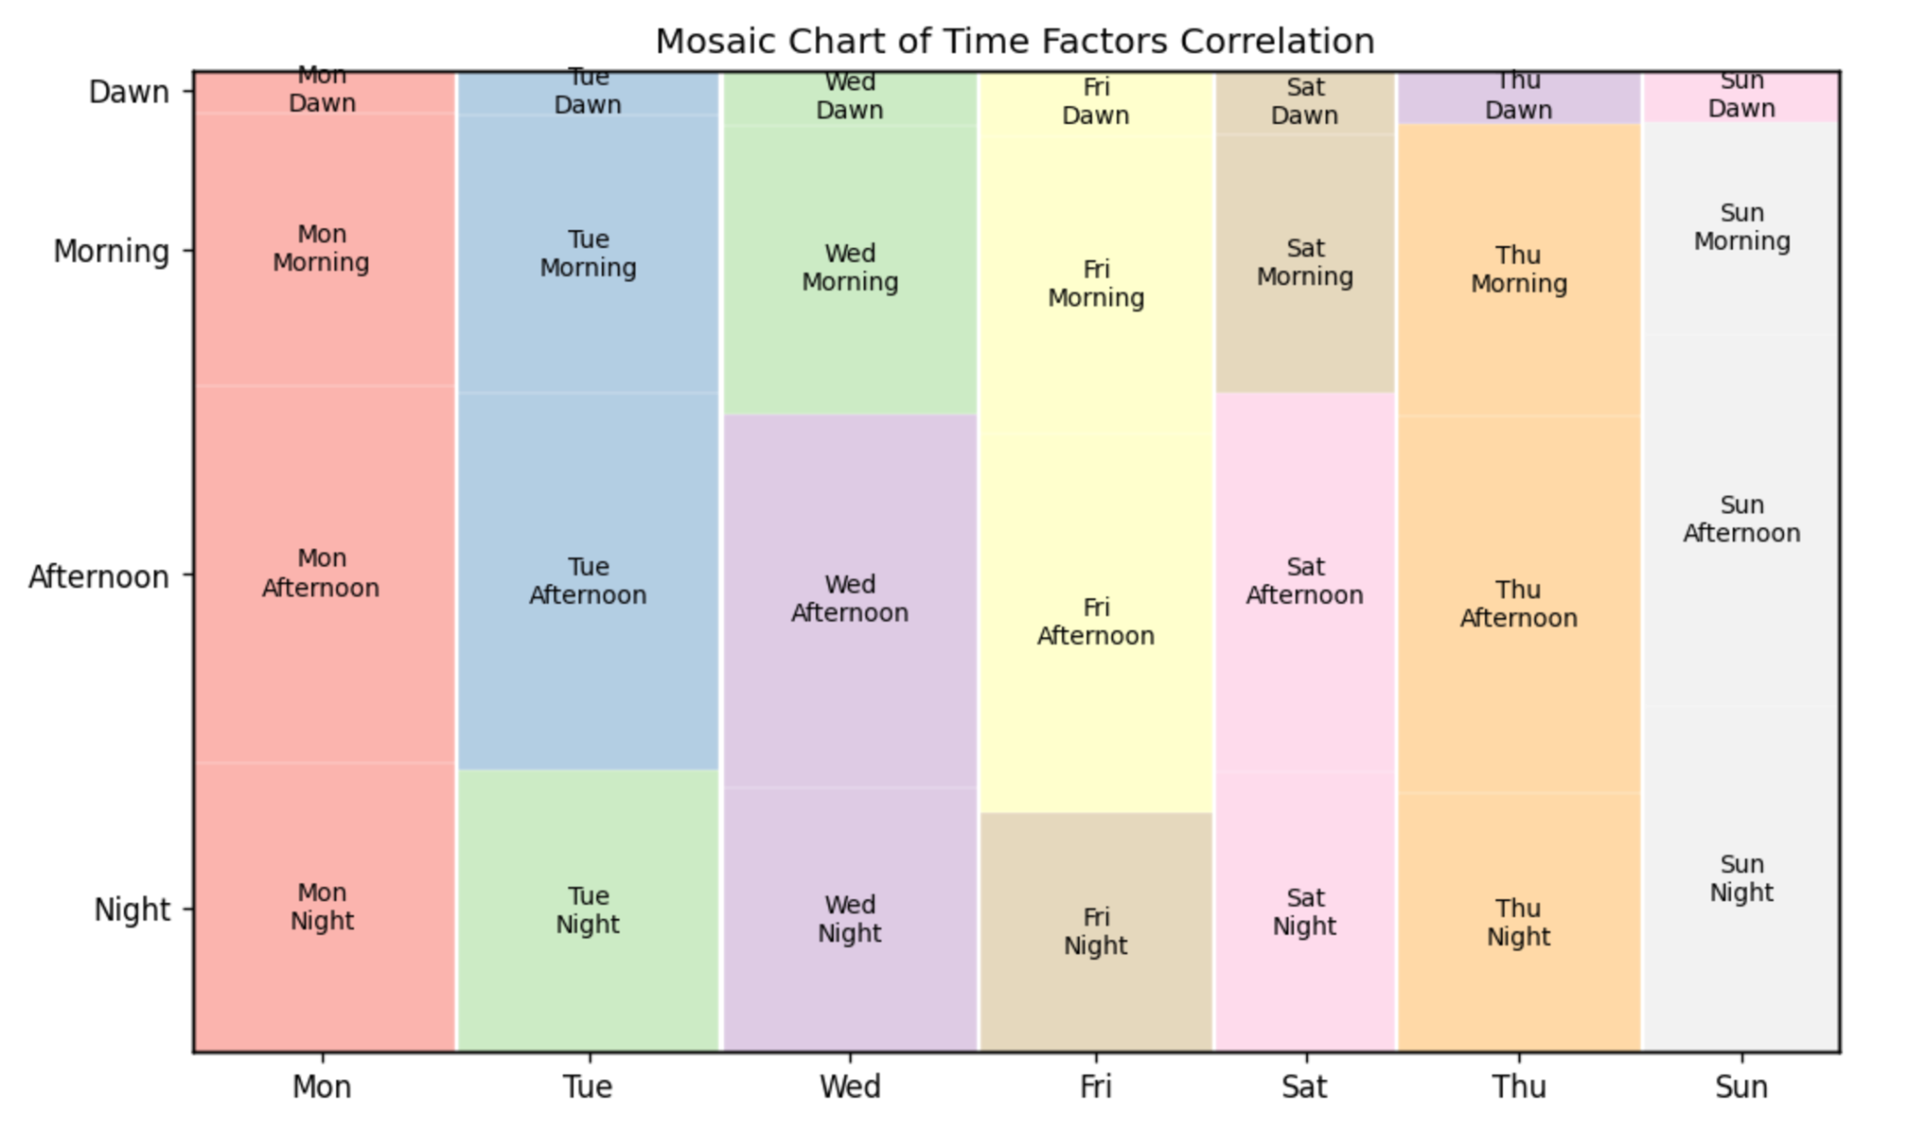
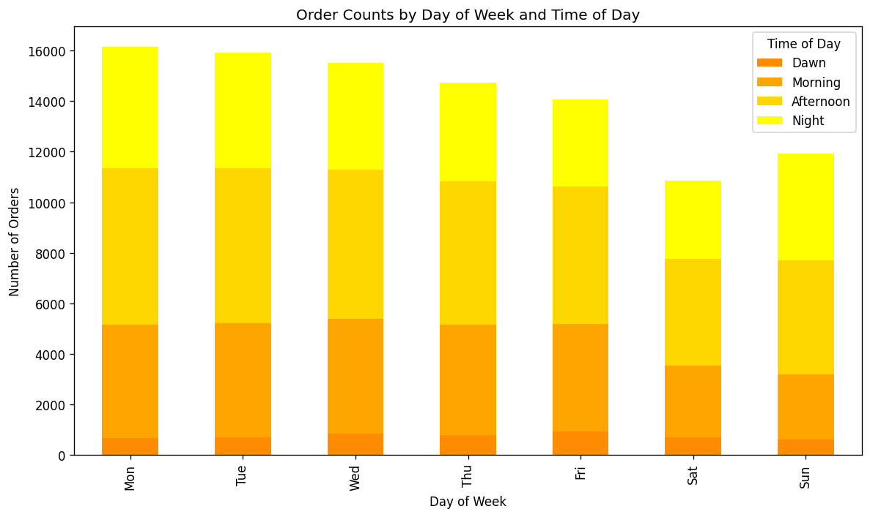
Purchase Preference By Time
Notes:
The mosaic and stacked bar plots below illustrate how customer purchasing preferences vary across different time dimensions, with afternoons and weekdays preferred the most, which can enable targeted suggestions for platform maintenance and resource allocation.
We also examined the customer’s purchase preference based on time of day and day of week, and tested the correlation of these two time-factors.
Results show that both of the time of day and day of week are significant on customer’s purchase preference, and there is a correlation between time of day and day of week in terms of customer purchase preference.
Specifically, customers generally prefer to purchase in the afternoons and mornings compared with dawns, prefer to purchase on weekdays compared with weekends.

Slide 17
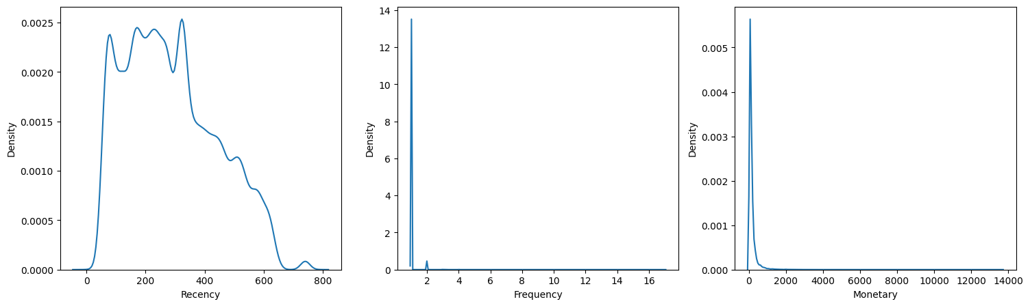
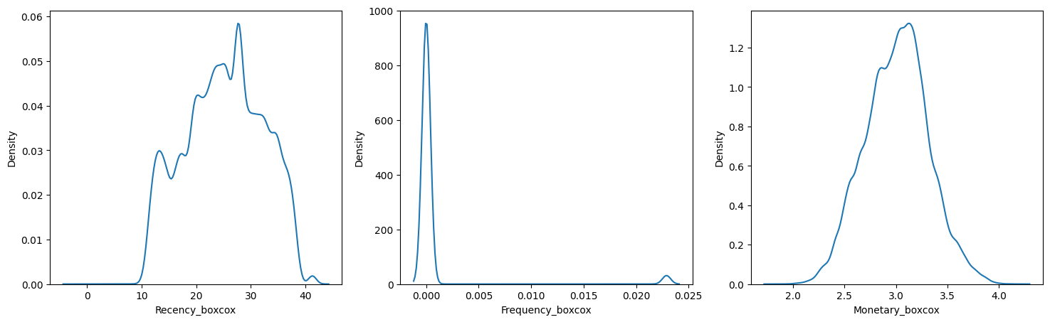
Payment Method Preference:
credit card vs. boleto vs. voucher vs. debit card
Kruskal-Wallis H test:
compare the 4 payment methods for Recency:
P-value: 4.20e-106
compare the 4 payment methods for Frequency:
P-value: 0.0432
compare the 4 payment methods for Monetary
P-value: 0.0
The difference of customer RFM among 4 payment methods
are significant.
Box-Cox transformation
Notes:
Next, we compared customer purchasing preference in payment methods. Same, we checked ANOVA assumptions and detected non-normality, then applied box-cox transformation but failed, and finally turned to the non-parametric test. Results showed significant difference of customer purchasing preference across payment methods.
For Payment method, we check ANOVA assumption first,but data is not normily distributed. Then we use BOX-COX transformation,but still not works for ANOVA. Then we use Kruskal-Wsllis Hypothesis test and the difference of customer RFM between 4 payment methods are significant.
Kruskal-Wsllis Hypothesis test shows the difference of customer RFM between 4 payment methods are significant.

Slide 18
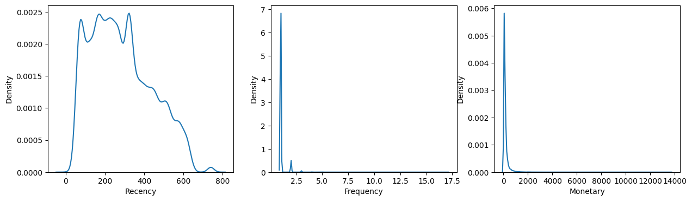
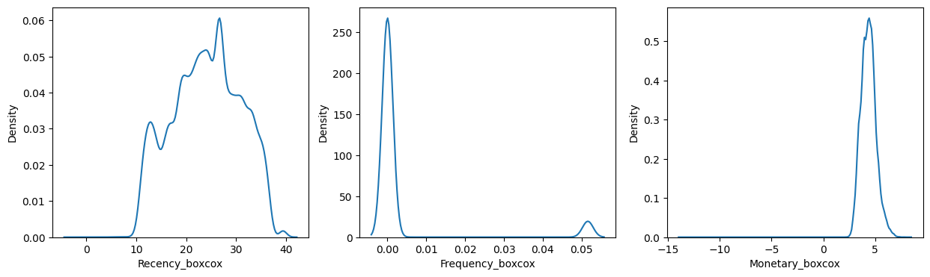
Geolocation (State): SP vs. RJ vs. MG
Kruskal-Wallis H test:
compare the 3 states for Recency:
P-value:9.21632377485e-49
compare the 3 states for Frequency:
P-value:0.04319221424761
compare the 3 states for Monetary
P-value:5.4374979354e-127
=>The difference of customer RFM between three geolocation groups SP, RJ, MG are significant.
Box-Cox transformation
Notes:
Kruskal-Wallis Hypothesis test shows the difference of customer RFM between 4 payment methods are significant..

Slide 19
RFM Modeling
Notes:
For customer segmentation, we first implemented RFM modeling to profile customers.
Customers who use olist platform have different needs and they have their own different profile. Therefore, we next step is do customer segmentation by RFM.

Slide 20
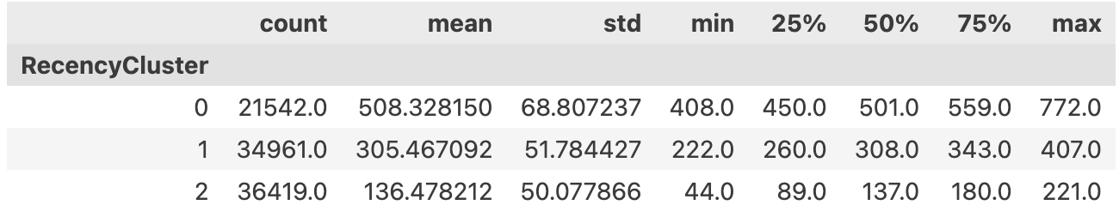
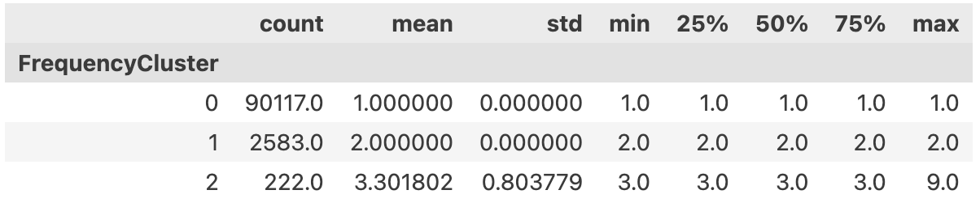
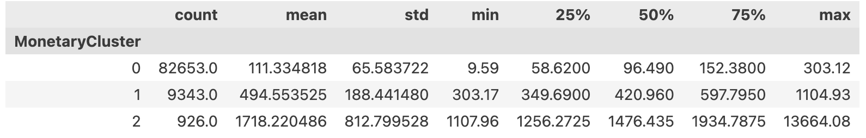
RFM Modeling
K-means with 3 clusters
(selected by silhouette)
Notes:
We applied k-means with 3 clusters on Recency, Frequency and Monetary respectively, reordered clusters from bad to good,
Recency is the number of inactive days for each customer, we will apply K-means* clustering to assign customers a recency score.
Cluster 2 covers most recent customers whereas 0 has the most inactive ones.

Slide 21
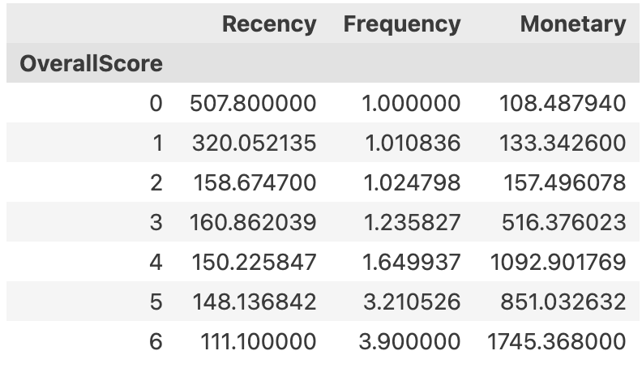
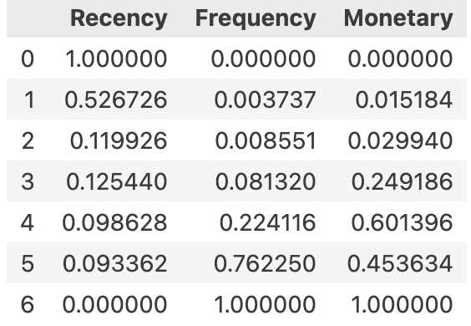
Overall Score: R + F + M
MinMax
Scaled
Notes:
And then calculated the overall scores ranging from 0 to 6
Then we add up the RFM score, and get overall score.
To keep consistency across the dataset and better visualization of next step, we use MinMaxScaled() function to narrow down the range from 0 to 1.

Slide 22
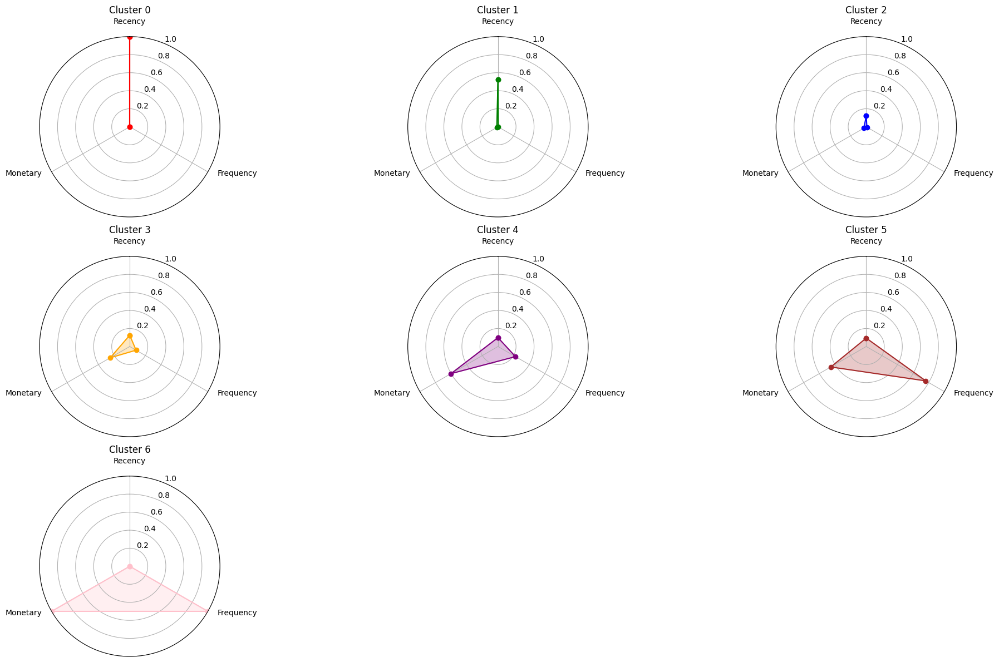
Cluster 0&1 | Churning Customers
Cluster 2 | New Customers
Cluster 3 | Need Attention Customers
Cluster 4 | Loyal Customers
Cluster 5 | Promising Customers
Cluster 6 | Core Customers
MinMax-Scaled Radar Plot
Notes:
From the radar plot, we grouped customers into 6 segments,
Here is MinMax-scaled Radar plot, and we re-group it by their feature.

Slide 23
0&1
Churning Customers
Low engagement and spending in a long period of time
2
New Customers
Engaged recently with infrequent purchases and low spending
3
Need Attentions
Moderate across Recency, Frequency and Monetary
💡
4
Loyal Customers
High engagement recently with high purchasing power
5
Promising Customers
High engagement recently with moderate purchasing power
6
Core Customers
High in all dimensions, most valuable customers
Notes:
And generated profile for each group based on descriptive statistics of RFM.

Slide 24
0&1
Churning Customers
Win-back campaigns: re-engagement incentives and emails
2
New Customers
Welcome programs: introductory offers, regular notifications
3
Need Attentions
Increase touchpoints: social media ads, loyalty rewards
🔍
4
Loyal Customers
Loyalty Programs: membership offers, involve in beta testing
5
Promising Customers
Upselling & Cross-Selling : bundle deals, volume discounts
6
Core Customers
VIP Services: priority & exclusive support, advocate incentives
Notes:
So that for each group of customers, Olist can provide targeted strategies for more effective marketing.

Slide 25
Customer Segmentation
Notes:
Following RFM Modeling, we conducted a further general segmentation based on all features, instead of only focusing on the RFM features.

Slide 26
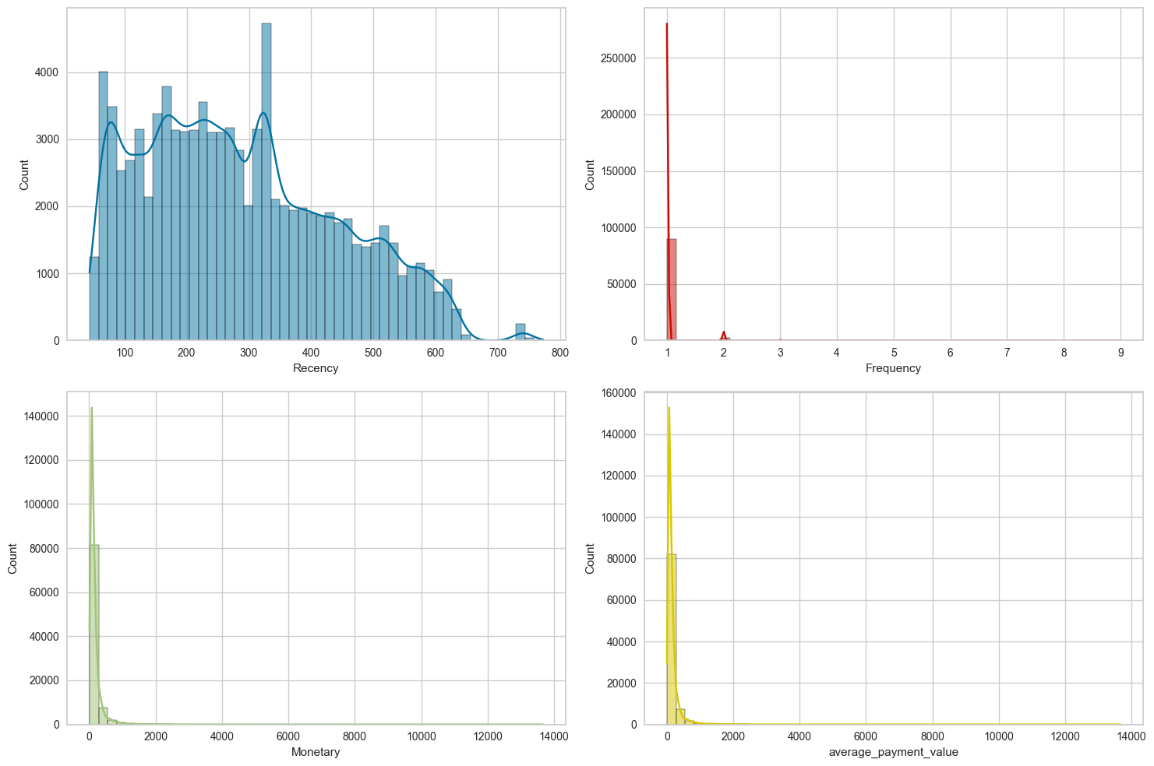
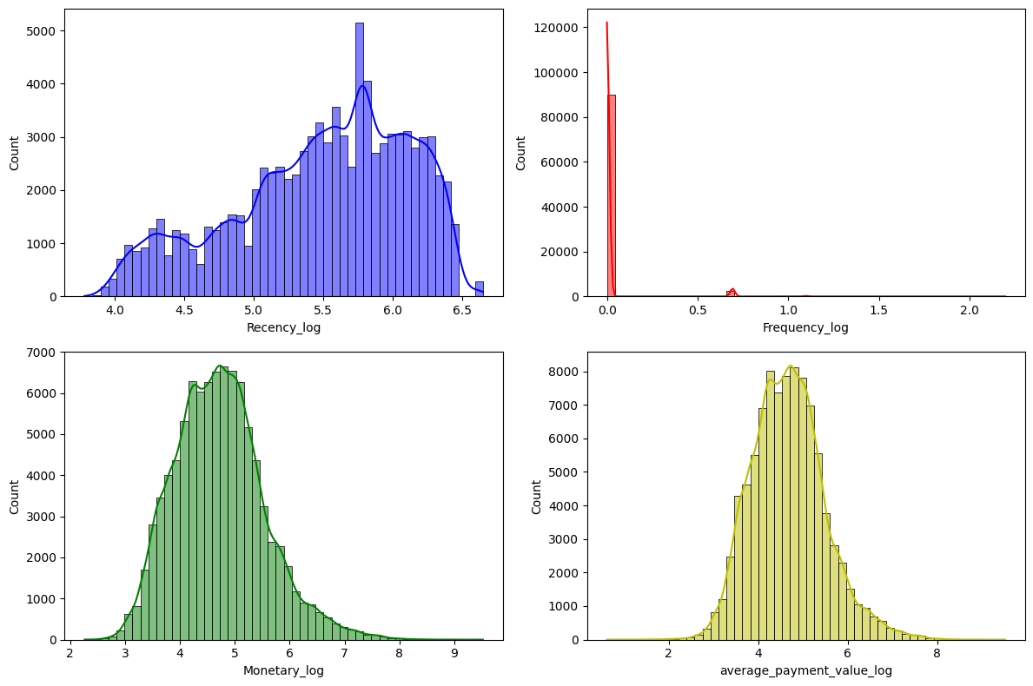
Preprocessing
RFM Skewness → Log Transformation
Frequency log
still not normal
Notes:
Before clustering, we processed the features for better performance. Firstly, we applied log transformation on the skewed features to mitigate the negative impact on distance-based measurements.

Slide 27
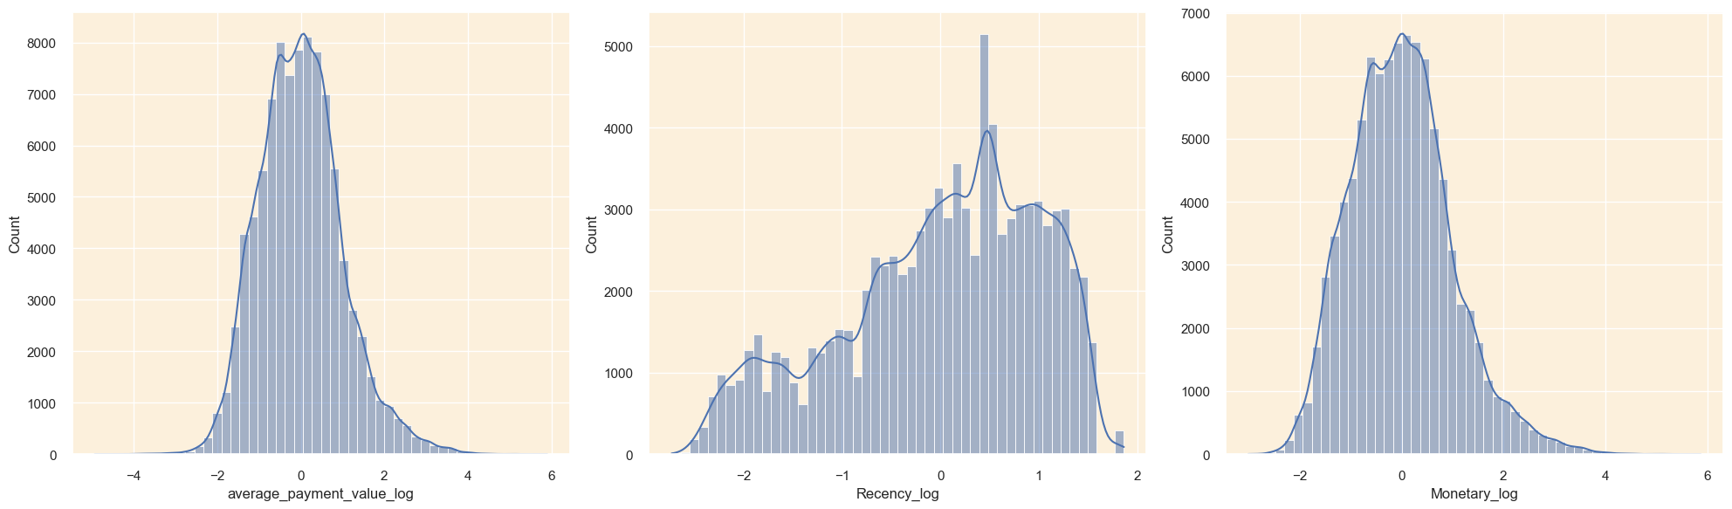
Preprocessing
Standard Scaling
on log(Recency), log(Monetary) and log(average payment value)
Notes:
And after transformation, we standardized all continuous features to normalize the scales before we jump to clustering.

Slide 28
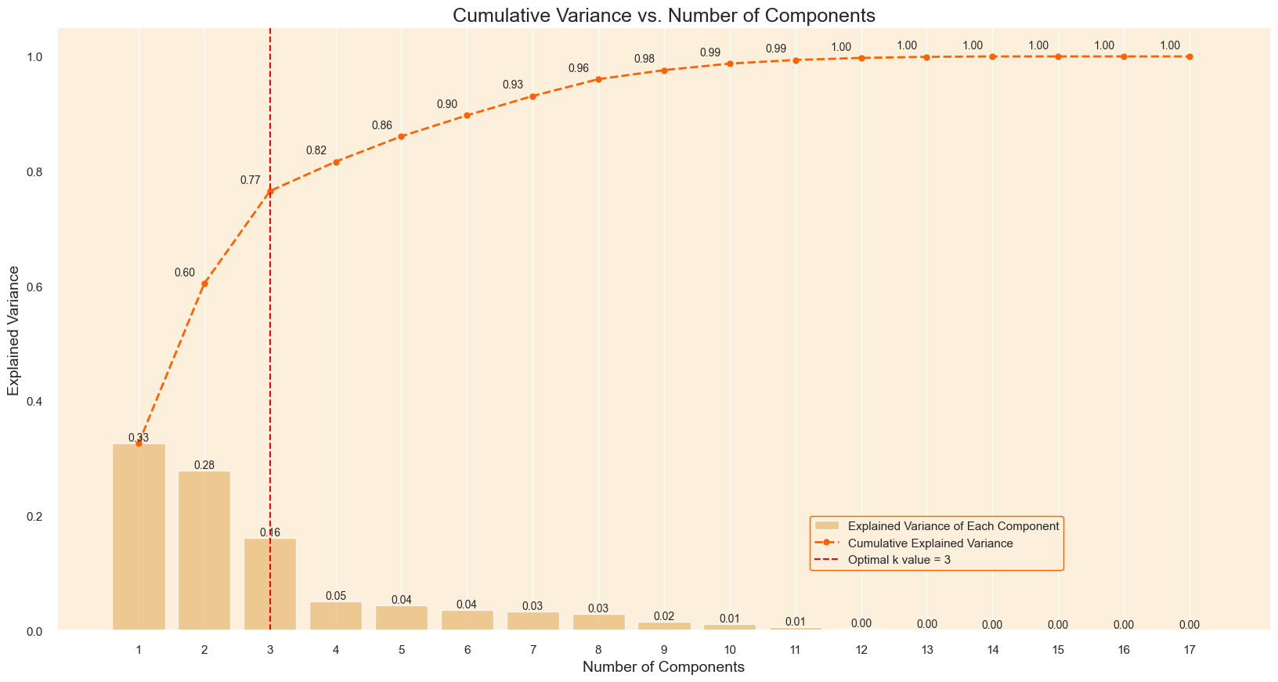
Preprocessing
Dimension Reduction — PCA
Select 3 principal components for clustering
Notes:
Then, we employed dimension reduction using PCA to filter noises and reduce computational costs, and we extracted the first 3 principal components based on the total variance explained.

Slide 29
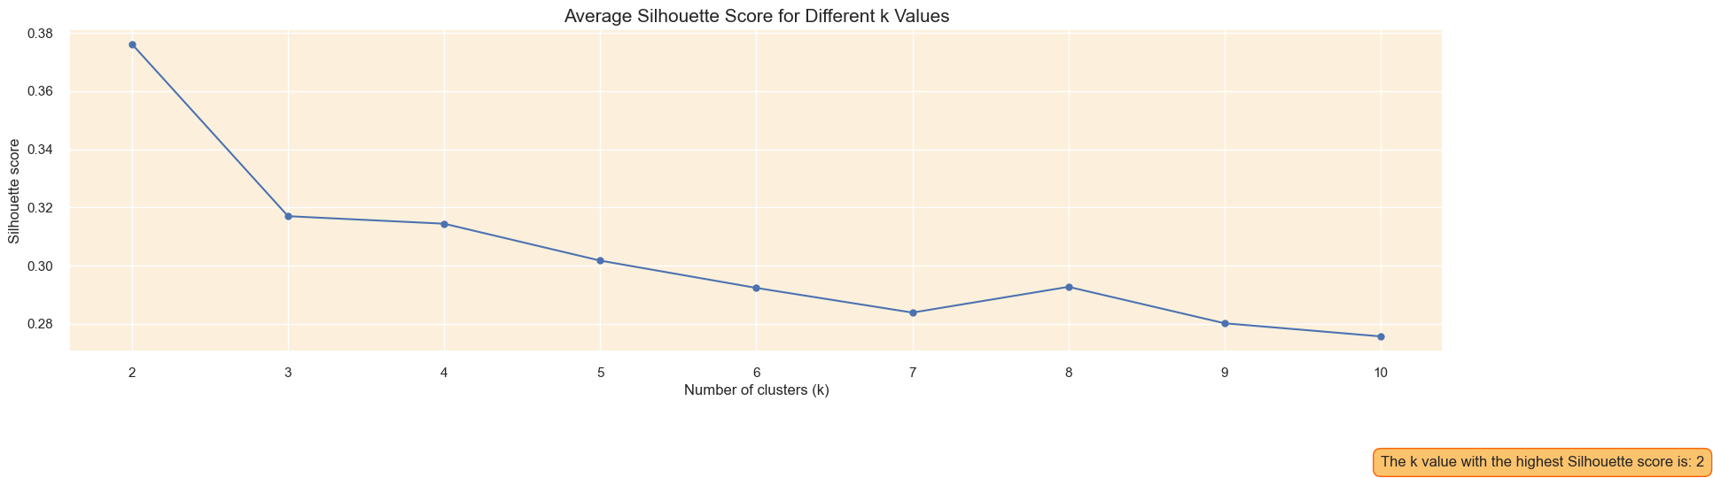
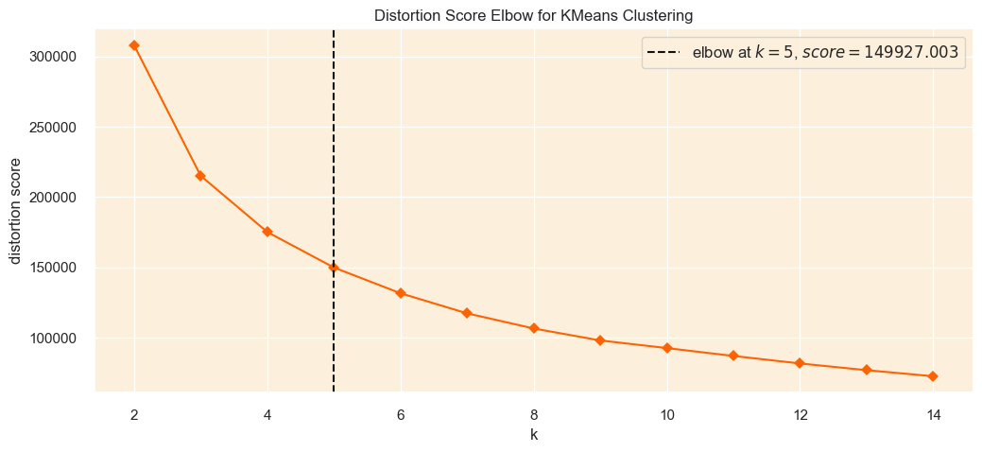
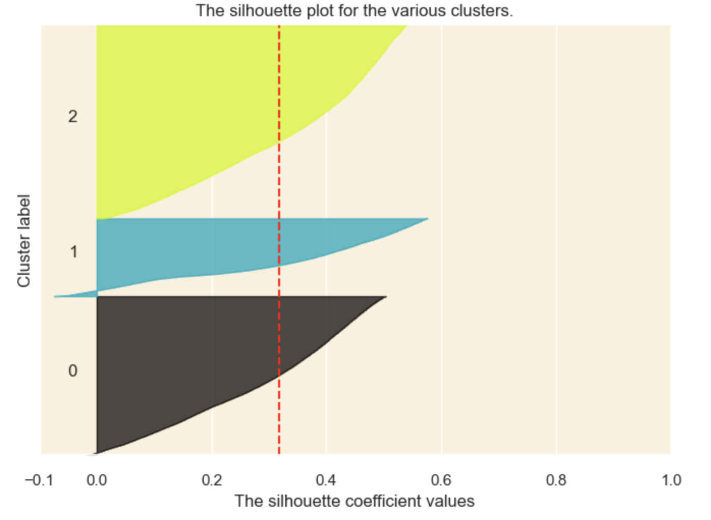
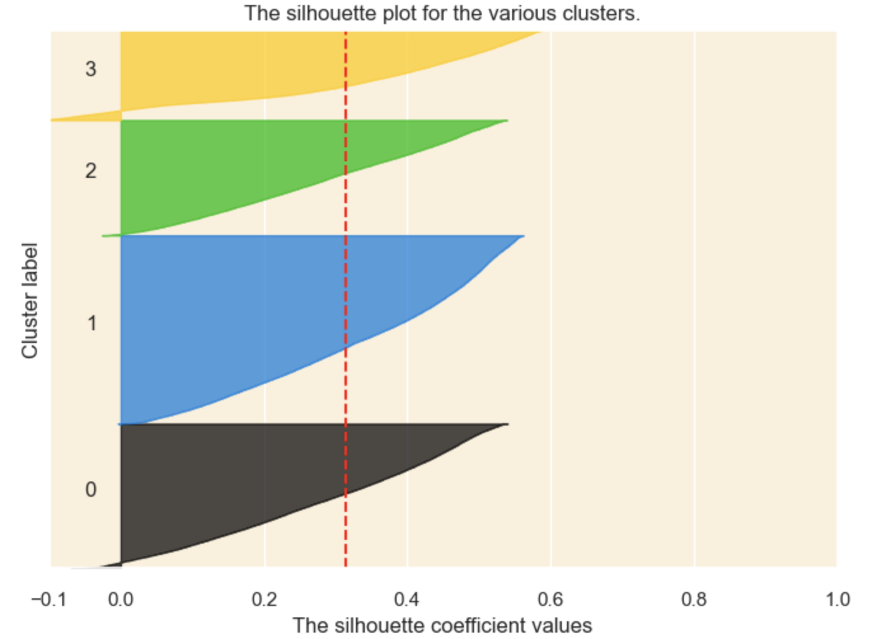
Clustering — KMeans
Select
k=3
Notes:
Then it comes to clustering. We tried Kmeans first, selecting the number of clusters by considering both the silhouette and the elbow method, and determined a k as 3.

Slide 30
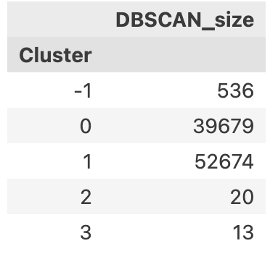
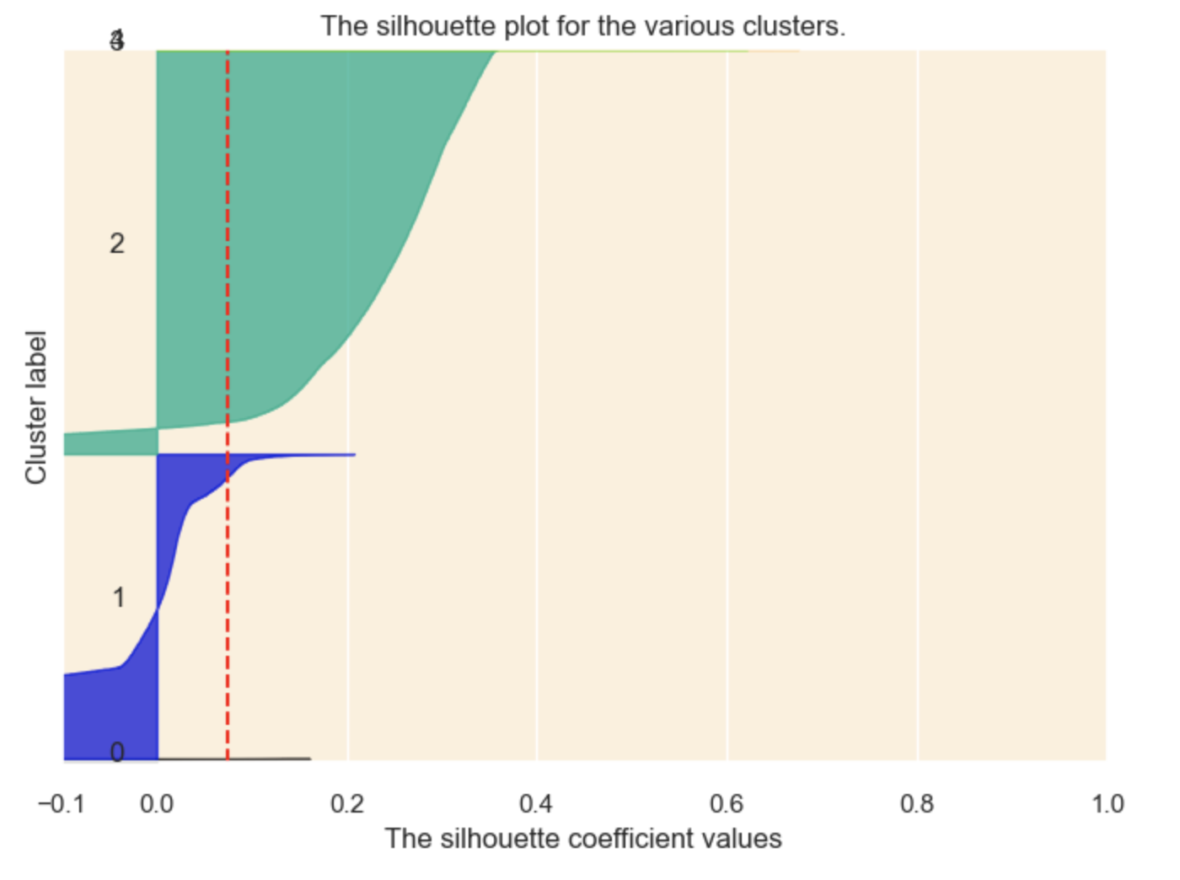
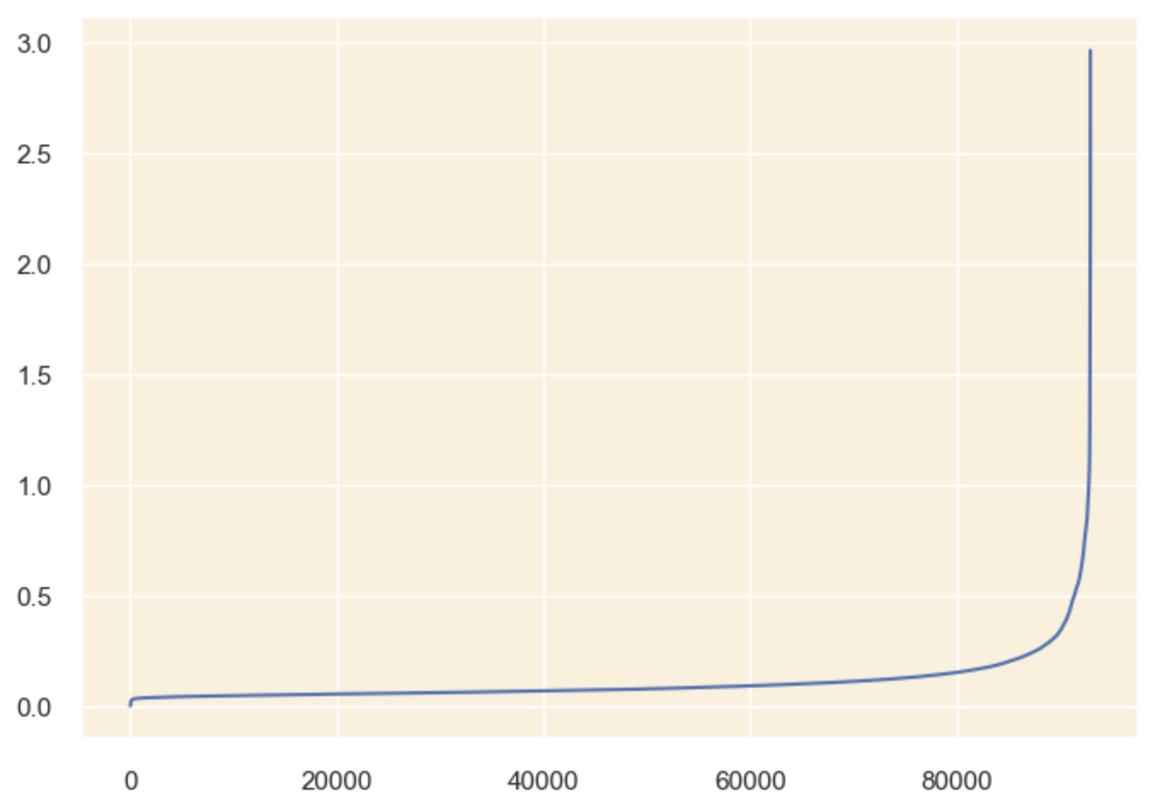
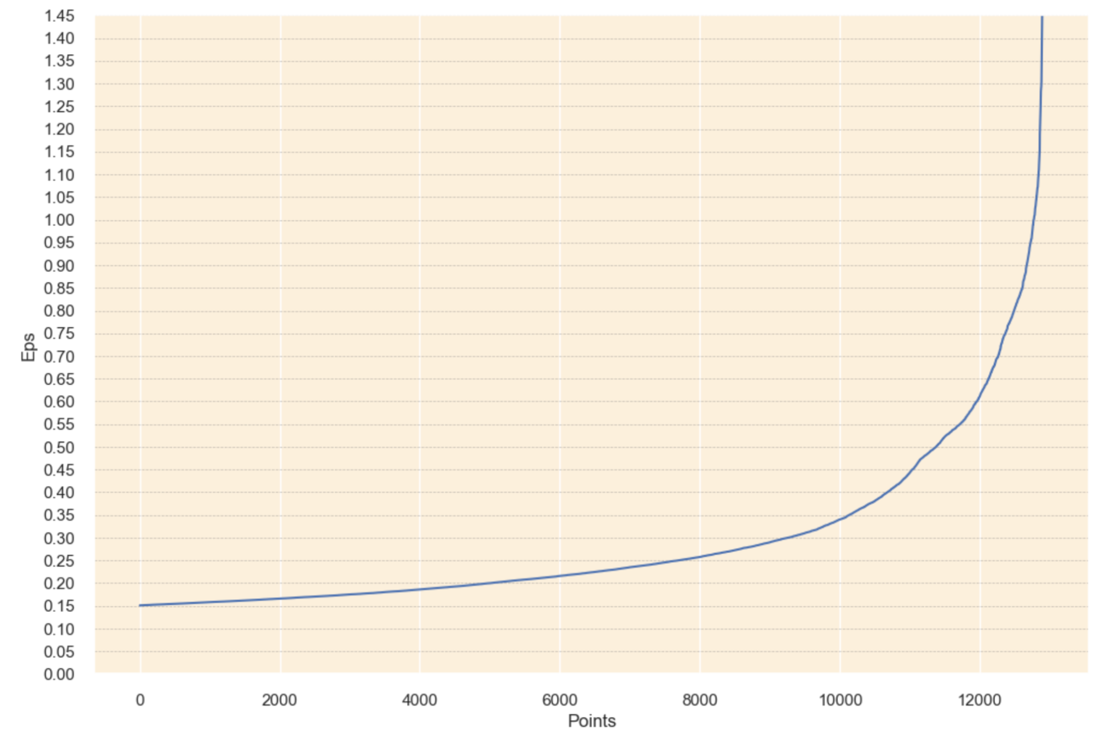
Clustering — DBSCAN ❌
Min_samples
Minimum points needed to form cluster
perform bad on customer segmentation
Hyperparameter Tuning
Epsilon
The radius of neighborhood
elbow point
Notes:
We also tried for DBSCAN, which is a popular clustering algorithm that can effectively handle noises and outliers. We tuned the hyperparameters, but it turned out the clusters are pretty imbalanced compared with kmeans.

Slide 31
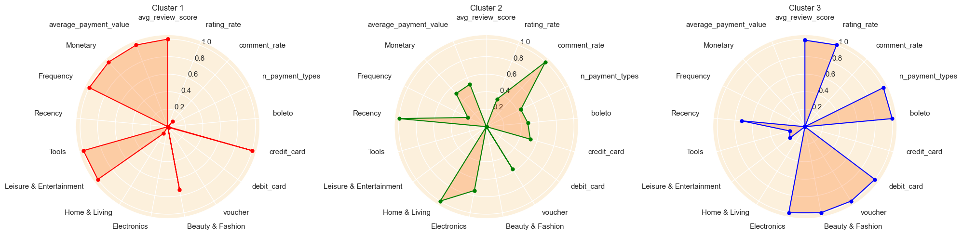
Customer Segmentation
MinMax Scaled Radar Plot
Notes:
Therefore, we utilized kmeans to group the customers into 3 clusters, which is shown on the radar plot.

Slide 32
Customer Profiling
1
2
3
Loyal, High-Value, but Low-Engagement
Engaged, Responsive, but Demanding
At-Risk, but Opportunistic
Loyalty
high frequency & high average review score
High-Value
high monetary & prefer high-value products
Low-Engagement
less responsive to marketing campaigns & low comment rate
Engaged
high comment rate
Responsive
highly responsive to marketing campaigns
Demanding
high comment rate but low average review score
At-Risk
low frequency, monetary and comment rate
but highly responsive to marketing campaigns
Opportunistic
high average review score
worth retaining
Notes:
And the 3 clusters are profiled as the following based on the descriptive statistics across all dimensions

Slide 33
Insights & Strategies
1
2
3
Relationship Marketing
&
Brand Advocate
Provide Personalized Value-Add Services:
loyalty membership, exclusive offers, etc.
Implement Referral and Advocate Program:
New member referral reward, incentives for
social media advocate, etc.
Targeted Promotion
&
Customer Support
Offer Tailored Marketing and Notifications :
Personalized coupons and vouchers, free samples,
Targeted email/text offers
Enhance customer feedback loop:
Priority comment reply, feedback surveys
Re-engagement Offer
&
Personalized Notification
Design Win-back Emails:
special offers for specific items, subscription and membership, with engaging contents and tones
Push Retargeting Ads on Social Media:
distribute tailored ads via Google Ads, Facebook Ads
1
2
3
Notes:
Based on that, we proposed tailored marketing strategies for each group: For group 1, the focus should be on enhancing relationship marketing . For group 2, it’s advisable to offer targeted promotions, as well as enhancing the customer support to improve their experience. For group 3, win-back emails for re-engagement would be helpful to lure them back.

Slide 34
Thanks For Listening!
Teamwork
Xingjian Liu: Data Manipulation & EDA, Feature Engineering, Multivariate Analysis, Customer Segmentation
Hongxuan An: Inferential Analysis, Comparative Analysis, RFM Modeling
Notes:
So that’s all for our presentation. The team contributions are shown below, and thanks again for your listening

